Slide 1
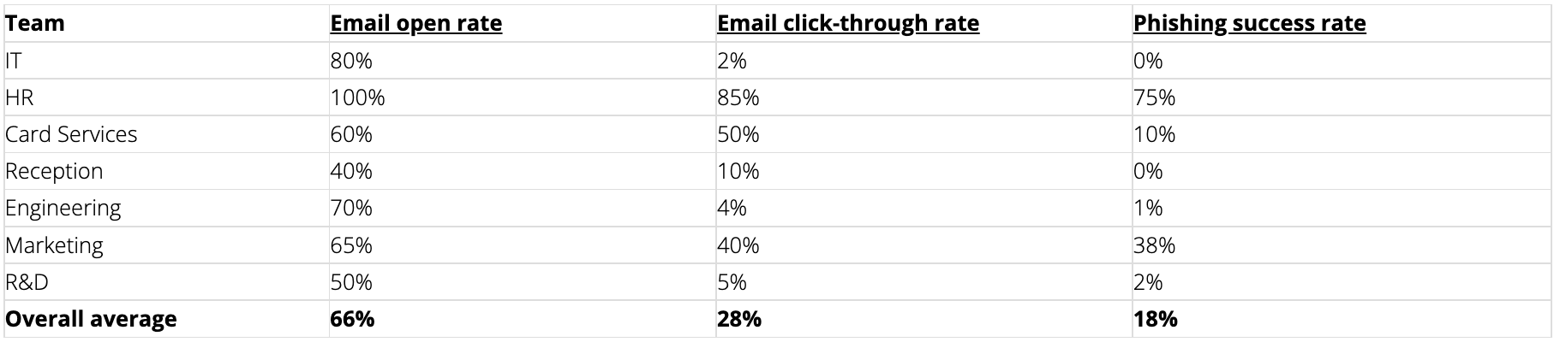
Familiarize yourself with phishing attacks
According to the analysis,

Slide 2
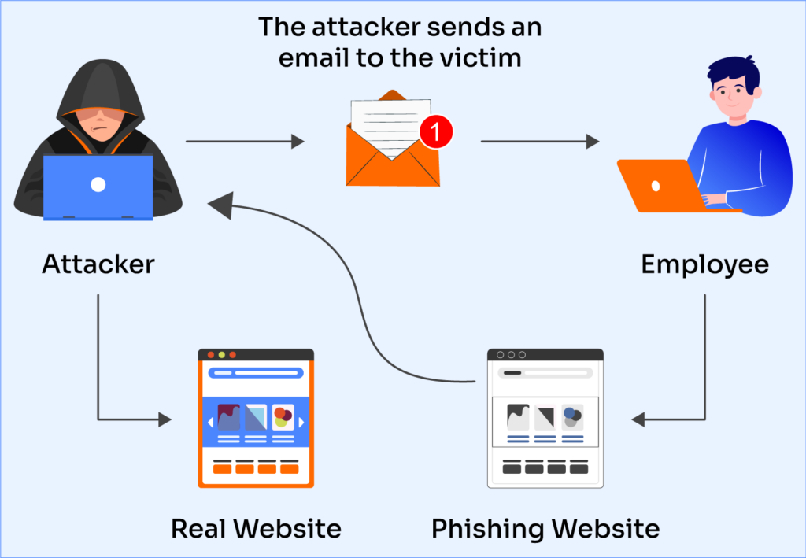
What is phishing?
Phishing exploits employee’s error or tricks employees to click a link or comply to a request which end up being used against the company.
Source: Valimail (nd)

Slide 3
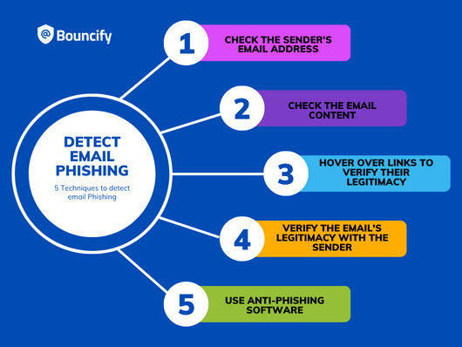
Learn to spot phishing emails
Source: Shanmugam, S. (2023)

Slide 4
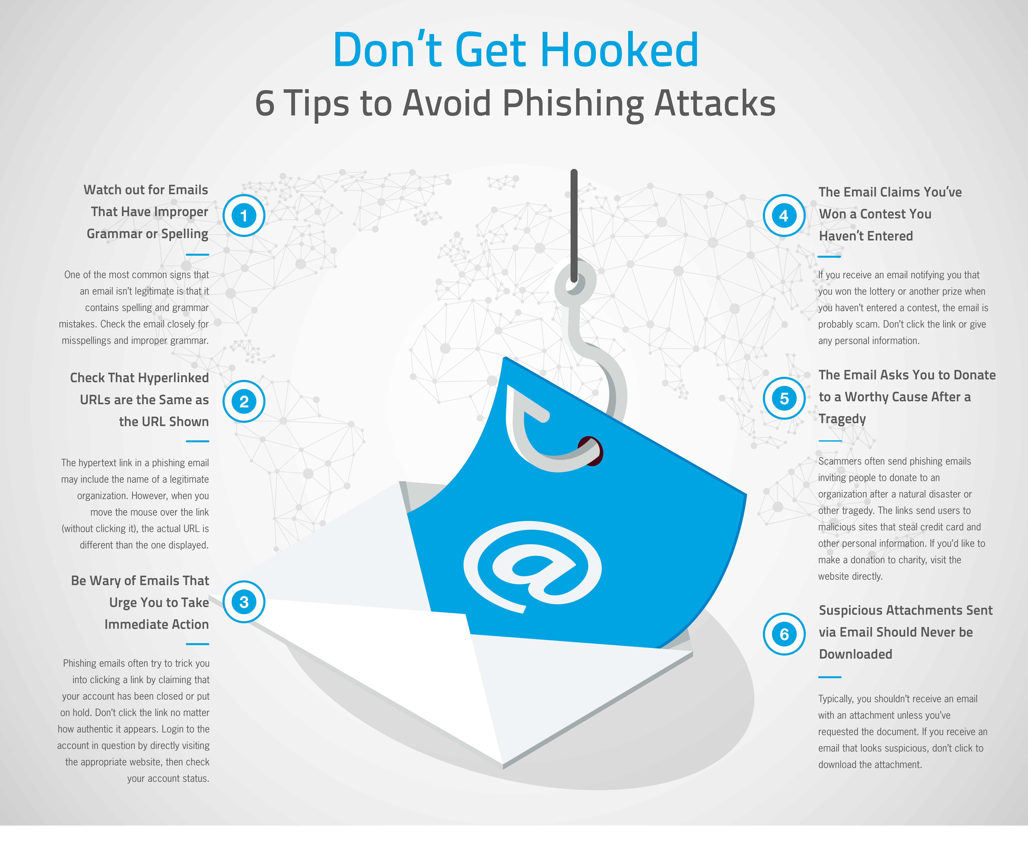
How do we stop getting phished?
Source: Hoverman, D. (2018)

Slide 5
Thank You

